Slide 1
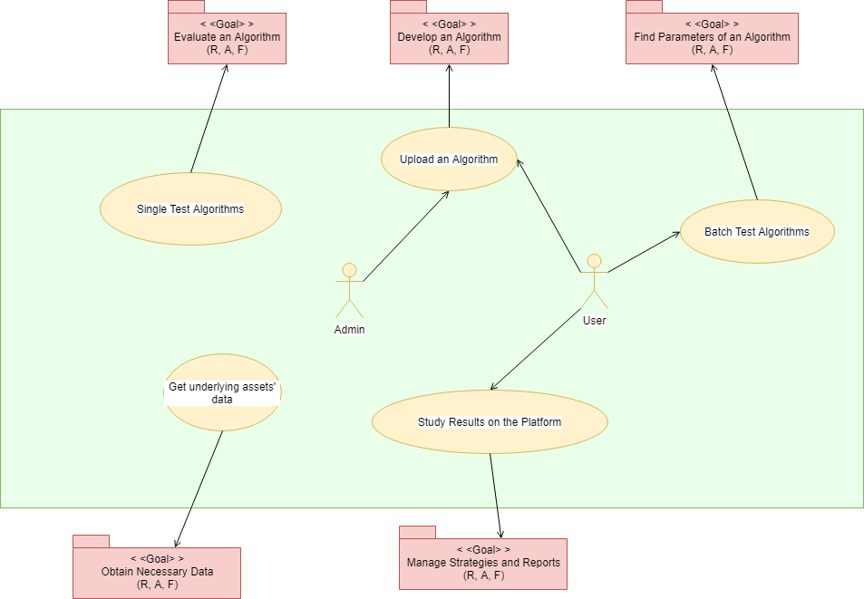

Slide 2
Use case spec.
Use Case ID | UC-003
Use Case Name | Call API to obtain underlying assets’ data
Goal | Get underlying assets’ data
Requirement | [BFR7 : Build a Library for Provide Underlying Assets’ Data provide] [BFR8 : Get specific Underlying Asset’s information]
Description | User gets the underlying assets by calling the API provided by Underlying Assets’ Data Process and Provide Module.
Actor | User
Basic Flow | import the library built by Underlying Assets’ Data Process and Provide Module Use the specific command to call Underlying Assets’ Data Process and Provide Module for the request data(e.g. data_for_trade.TX.all() ) Underlying Assets’ Data Process and Provide Module gets the call and takes out the request data stored in file source and put them in some data structure(e.g. list of dictionary) Underlying Assets’ Data Process and Provide Module returns that data back to where the call comes from
Alternative Flow | Necessary parameter not provide, go back to step 2 The assets’ data of parameter specified is not available, go back to step 2

Slide 3
Scenerio
ID | Scenero Name | Staring Flow | Alternate
S1 | Successfully get the assets’ data | Basic Flow
S2 | Necessary parameter not provide | Basic Flow | A1
S3 | Data with specified parameter not available | Basic Flow | A2

Slide 4
Testcases
Scenerio | product_id(*) | start_date | end_date | Expected Result
S1 - Successfully get the assets’ data | 0 | 2004-07-01 | 2021-03-16 | return corresponding assets’ data in a list of dictionary
S1 - Successfully get the assets’ data | 0 | None | None | return corresponding assets’ data in a list of dictionary
S1 - Successfully get the assets’ data | 0 | 2004-07-01 | None | rreturn corresponding assets’ data in a list of dictionary
S1 - Successfully get the assets’ data | 0 | None | 2021-03-16 | return corresponding assets’ data in a list of dictionary
S2 - Necessary parameter not provide | None | 2012-12-31 | 2017-03-30 | return -1
S3 - Data with specified parameter not available | 87 | 2011-07-05 | 2019-07-10 | return -2
S3 - Data with specified parameter not available | 0 | 2004-07-01 | 2021-08-16 | return -2
S3 - Data with specified parameter not available | 0 | 2000-04-01 | 2021-08-16 | return -2

